Slide 1
Map Coloring
Map coloring is a classic graph coloring problem in computer science and mathematics.
The goal is to assign colors to regions on a map so that no two adjacent regions share the same color.

Slide 2
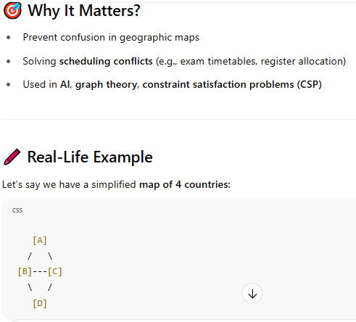
Map Coloring

Slide 3
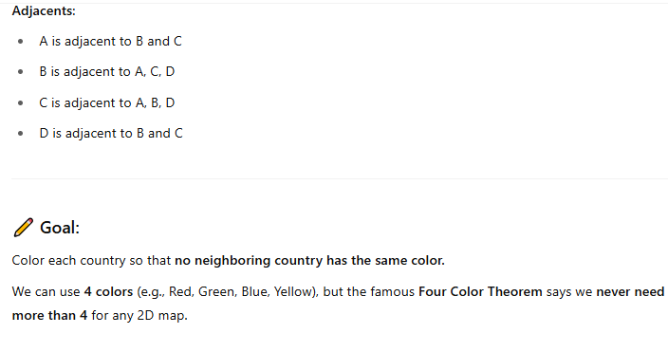
Map Coloring

Slide 4
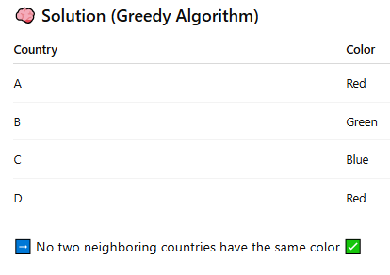
Map Coloring

Slide 5
